Slide 1
Application Architecture
James Chambers| Senior Software Developer
Simon Timms| Senior Software Developer

Slide 2
Course Topics
Applications on Azure: Putting the Pieces Together
01 | Introduction | 05 | Azure Storage
02 | Application Architecture | 06 | Docker and Log Management
03 | DNS | 07 | AutoScale
04 | Batch | 08 | Review and Summary

Slide 3
Course Topics
Applications on Azure: Putting the Pieces Together
01 | Introduction | 05 | Azure Storage
02 | Application Architecture | 06 | Docker and Log Management
03 | DNS | 07 | AutoScale
04 | Batch | 08 | Review and Summary

Slide 4
Batch
Please leave this area blank to allow for picture in picture recording

Slide 5
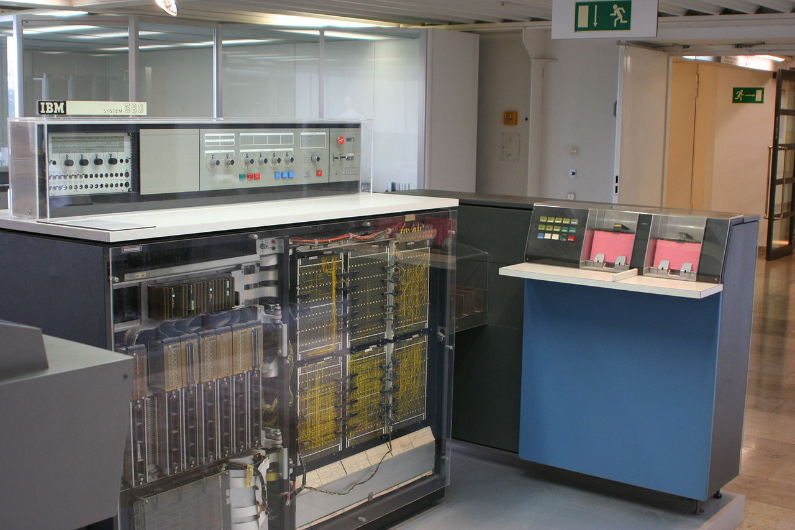
Historically
Historically
"DM IBM S360" by Ben Franske - DM IBM S360.jpg on en.wiki. Licensed under CC BY 2.5 via Commons - https://commons.wikimedia.org/wiki/File:DM_IBM_S360.jpg#/media/File:DM_IBM_S360.jpg
Notes:
This is an IBM 360 delivered between 1965 and 1978. This particular image is of an IBM 360-20 which is the smallest and cheapest member of the 360 family. It is only barely a mainframe and would later be classified as a microcomputer. Notice on the right the pink stacks of cards. Those are being fed into an IBM 2560 MFCM or multi function card machine. You would write a program

Slide 6
Examples of batches
Please leave this area blank to allow for picture in picture recording
Month end processing
Nightly reports
Encoding of videos
File format conversions
Scientific applications such as SETI or protein folding
Notes:
Talk about oil well accounting. Generating bills for customers is a great example of a batch process. Every month you get a cell phone bill which is likely generated through a batch process. Batches are great for easily divisible very large scale jobs.

Slide 7
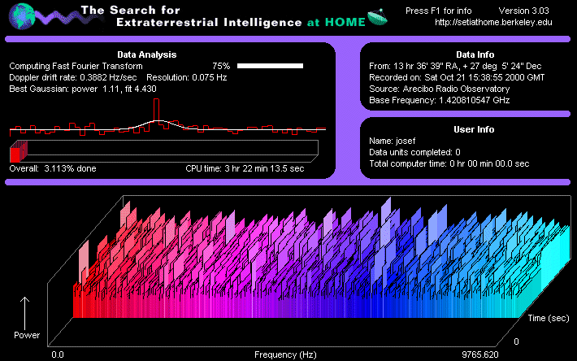
Examples of batches
Please leave this area blank to allow for picture in picture recording
Notes:
If you’re of a certain age. Arecibo space telescope

Slide 8
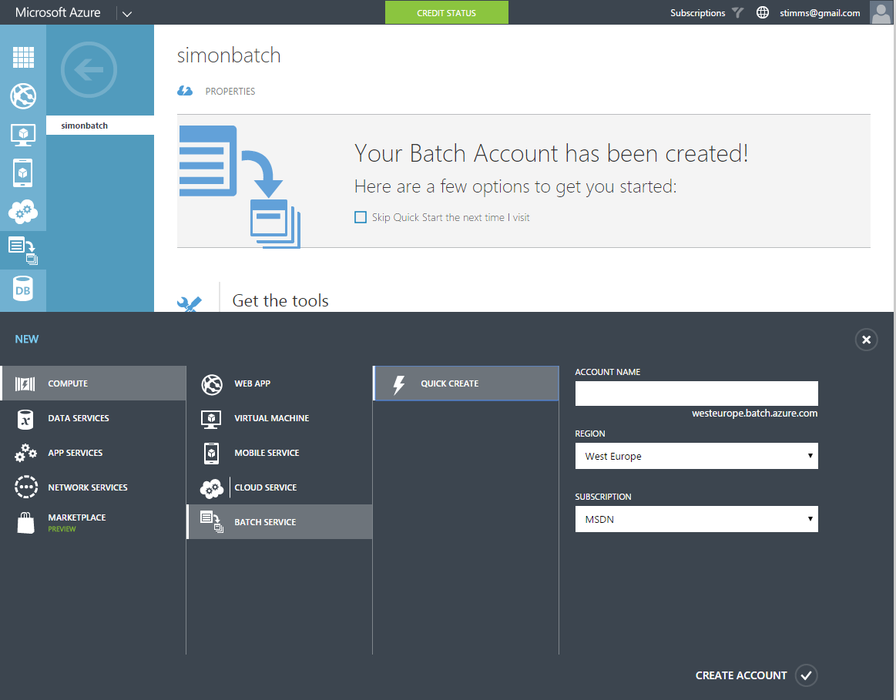
Azure Management Portal
Please leave this area blank to allow for picture in picture recording

Slide 9
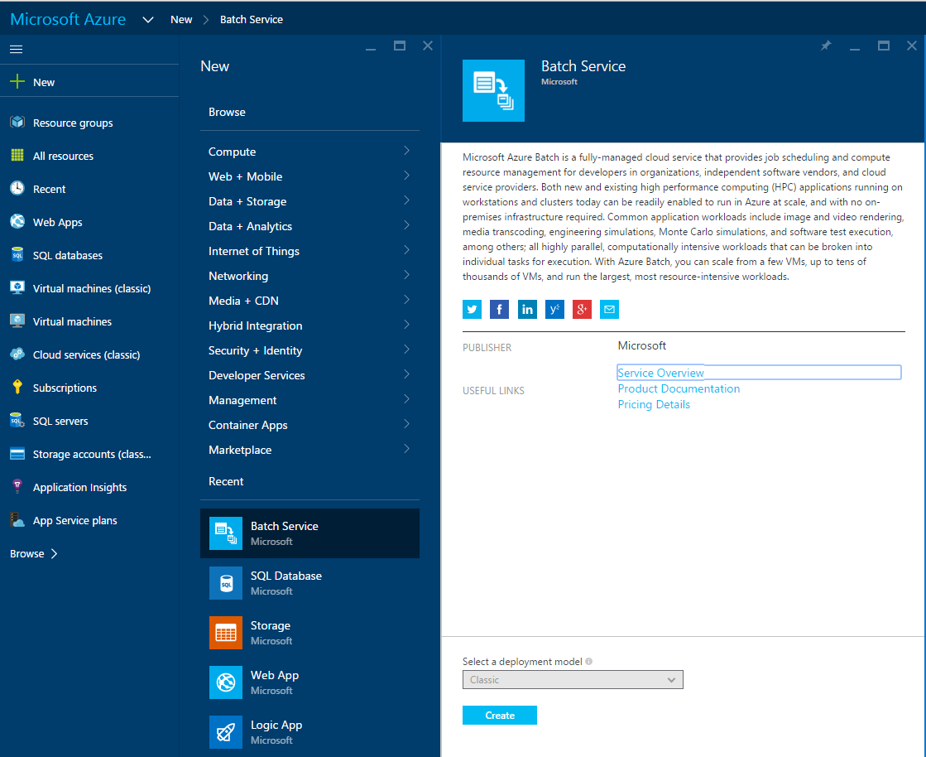
Azure Portal
Please leave this area blank to allow for picture in picture recording

Slide 10
Putting it together yourself
Please leave this area blank to allow for picture in picture recording
C#
Notes:
To build batch ourselves we would need to have a pool of virtual machines. They would need to use blob storage to contain the inputs and outputs from each task. We would also need to tie in some form of automatic scalling

Slide 11
Things to consider
Please leave this area blank to allow for picture in picture recording
Retry logic
How to scale up and down
Storage of artifacts
Notes:
To build batch ourselves we would need to have a pool of virtual machines. They would need to use blob storage to contain the inputs and outputs from each task. We would also need to tie in some form of automatic scaling

Slide 12
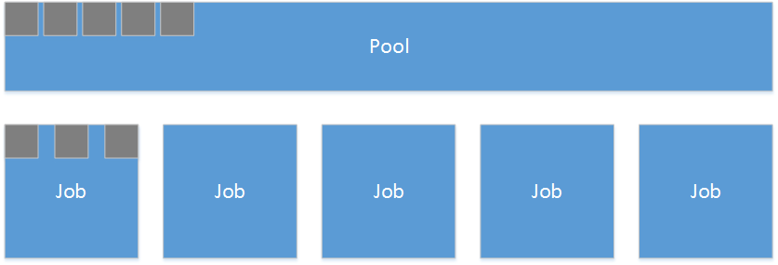
Batches on Azure
Please leave this area blank to allow for picture in picture recording
Notes:
After this we’re going to drop to code to see setting up a pool and jobs and tasks

Slide 13
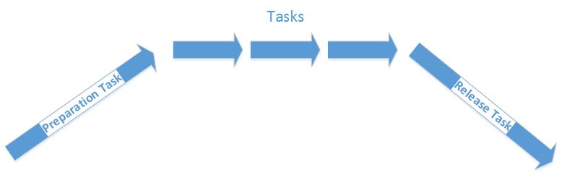
Lifecycle
Please leave this area blank to allow for picture in picture recording

Slide 14

Scheduling
Please leave this area blank to allow for picture in picture recording
Notes:
We can schedule tasks to run at a particular time. You might want to do this if you’re doing month end processing or year end processing or even if you have a task that can run when the pool isn’t so hot. Say you do 90% of your traffic during the working day then you could schedule maintenance tasks after the work day when the pool isn’t so hot but you don’t want to spin down all the instances

Slide 15

Scaling
Please leave this area blank to allow for picture in picture recording
Notes:
Can be scaled right to the moon. Literally 10s of thousands of nodes. I can’t imagine many scenarios where you would need that but something like protein folding would be a good example. Really doesn’t cost you any more to run experiments quickly on many nodes than slowly on few nodes. All you’re paying is the startup time

Slide 16
Cost
Only the cost of the underlying resources
Blob storage
Compute
Anything else used by the tasks

